Slide 1

Applications of Cloud Technology in Public Administration
Prepared by:
Rashid Ali
June 6th, 2017
Higher School of Economics , Moscow, 2016
www.hse.ru

Slide 2

Contents
Introduction
Cloud Strategy for Public Administration in European countries
Cloud Applications for Public Administration
Conclusion
Higher School of Economics , Moscow, 2016

Slide 3
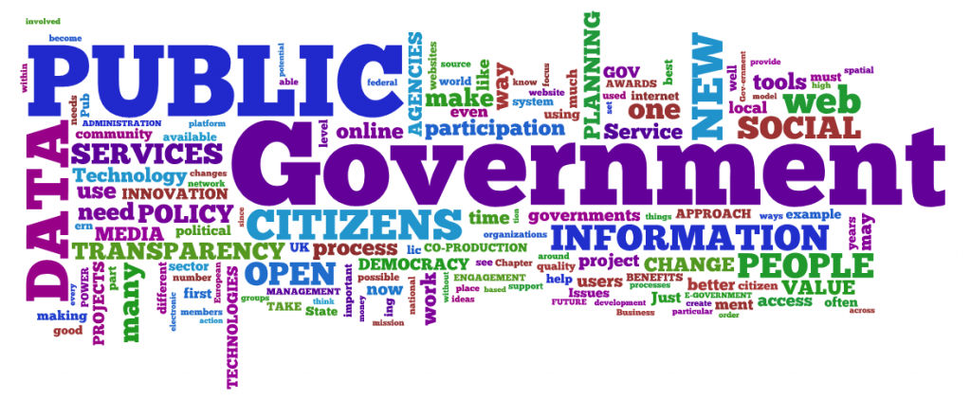
Introduction
Why Cloud computing in Public Administration ?
Higher School of Economics , Moscow, 2017
Notes:
Public administration deals with management of resources in public sector to serve the citizens of a country.
Over the past decade, governments across the world and at all levels have adopted electronic government to provide services to their citizens in public sector. However, many developing countries still face difficulties to implement E-government initiatives in public sector leading to a high level of failure. The most experienced challenges and barriers across the relevant studies include technological barriers, lack of resources, cost, digital divide, poor management and infrastructure, and lack of IT infrastructure.
E-governments around the world are seriously looking into cloud computing as mean of increasing efficiency, reducing cost, providing more reliable and efficient services, and reducing cycle time. Cloud computing is one of the new technologies which can significantly improve a government function, the services it provides to its citizens and institutions, and its cooperation with other governments.

Slide 4
Cloud Strategy for Public Administration
1. The Portuguese cloud strategy for Public Administration
Strategy Drivers:
    • Cost savings
    • Economic impact for the private sector
    • Improvement of existing public services
Main objectives:
    • The introduction of cloud services
        in public administrations
    • Implementation of the GO-Cloud (Governmental Open Cloud), a platform with shared cloud services;
Higher School of Economics , Moscow, 2016

Slide 5
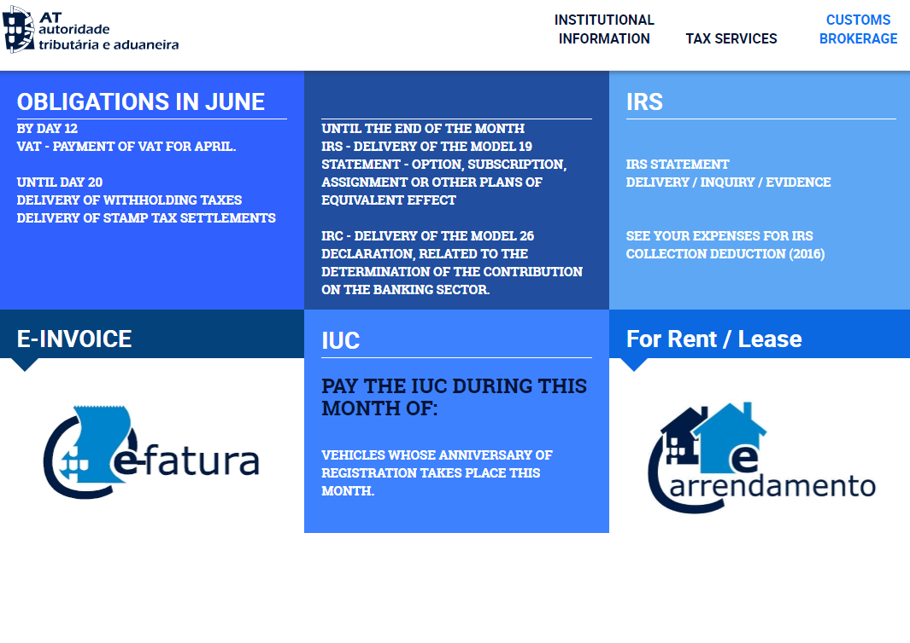
Cloud Application for
Public Administration
1. The Portuguese public administration provides internet portals with information, features and services for key administrative areas, particularly in the context of social security, taxes and customs administration:
http://www.portaldasfinancas.gov.pt
Higher School of Economics , Moscow, 2016
Notes:
To ensure the settlement and collection of taxes on income, wealth and consumption, customs duties and other taxes

Slide 6
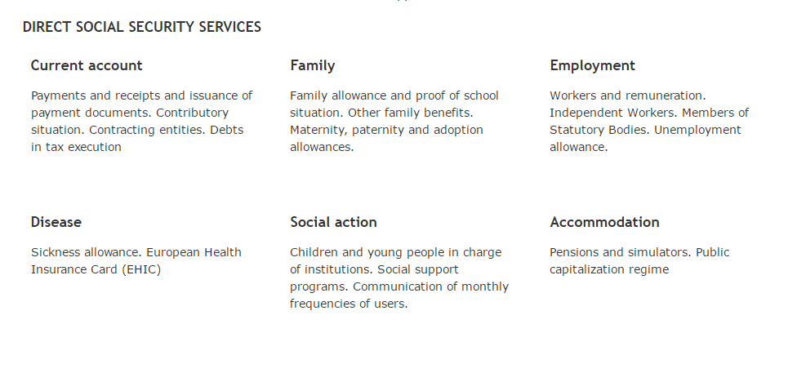
Cloud Application for
Public Administration
2. https://www.seg-social.pt/consultas/ssdirecta
Higher School of Economics , Moscow, 2016

Slide 7
Cloud Strategy for
Public Administration
2. The Italian cloud strategy for Public Administration
  Strategy Drivers:
  • Cost savings
  Improvement of existing public services
  Main objective:
  • Rationalization of data centers using latest cloud technology for
  public administration services
Higher School of Economics , Moscow, 2016
Notes:
According to data produced by Assinform and NetConsulting, the Italian public sector system, for this set of inadequate infrastructure, bears a current expenditure of more than 10 BEUR a year.

Slide 8
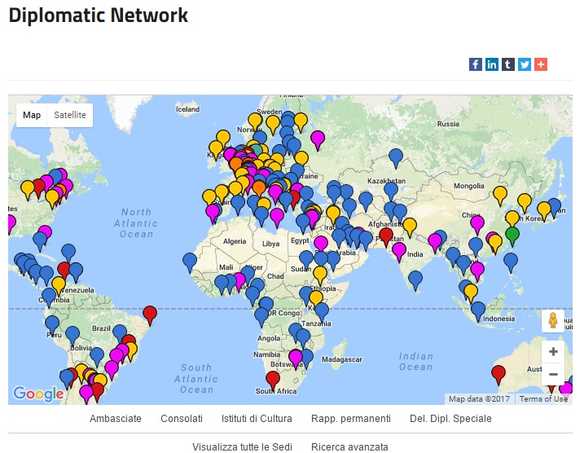
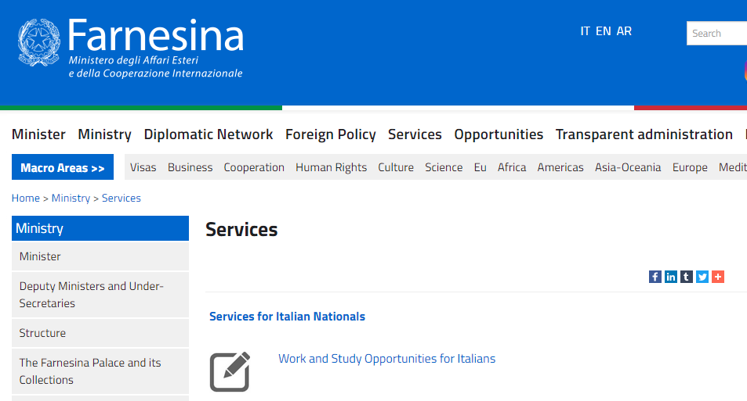
Cloud Application for
Public Administration
1. The Italian Ministry of Foreign Affairs has developed a private Cloud (“Maecloud” project) to ensure service continuity for Italians citizens abroad.
Higher School of Economics , Moscow, 2016
Notes:
The Italian Ministry of Foreign Affairs has developed a private Cloud (“Maecloud” project) to ensure service continuity for Italians citizens abroad. Public administrations, foreign offices and central offices of the ministry are connected by SIFC (integrated system board functions), a platform that integrates the management of services for citizens abroad and for enabling co-operation between public administrations, to increase the effectiveness of communication with and from the public abroad.

Slide 9
Cloud Strategy for
Public Administration
3. The Netherlands cloud strategy for Public Administration
  Strategy Drivers:
    • Improved and new modes of working
        for the central government
    • Cost saving
  Main objective:
    • Closed cloud
    • Cloud first policy
Higher School of Economics , Moscow, 2016

Slide 10
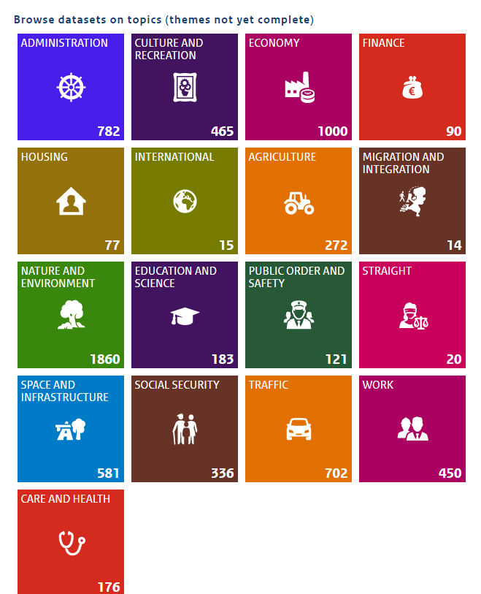
Cloud Application for
Public Administration
1. OPEN DATA PORTAL
Higher School of Economics , Moscow, 2016
Notes:
In Netherlands, open data is offered by central government to society and is supported by various public cloud-based solutions. These solutions are developed based on cloud computing for free public services. The solution includes National Georegistry, PDOK viewer and open data portal. PDOK enables Web services available nationwide geo-information from governments. This data comes directly from the source, i.e. government organizations source holder of this data. Therefore, the data up to date and reliable. Moreover, they are by each customer (government, business, individual) to use free of charge. This open data portal of the national government stored data sets of all Dutch governments. They do this by acting as a central registry and as a site of government data. They work with ministries, municipalities, water boards and provinces to open up data. They also support and deliver information to those who want to know more.

Slide 11
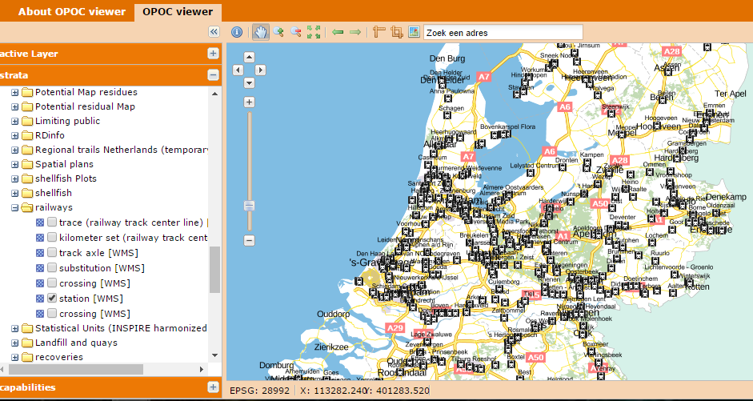
Cloud Application for
Public Administration
2. PDOK viewer -http://pdokviewer.pdok.nl/index.html
Higher School of Economics , Moscow, 2016
Notes:
PDOK enables Web services available nationwide geo-information from governments. This data comes directly from the source, ie government organizations source holder of this data. Therefore, the data up to date and reliable. Moreover, they are by each customer (government, business, individual) to use free of charge.

Slide 12
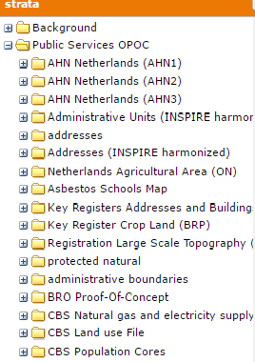
Cloud Application for
Public Administration
2. Other Services by PDOK viewer
Higher School of Economics , Moscow, 2016

Slide 13
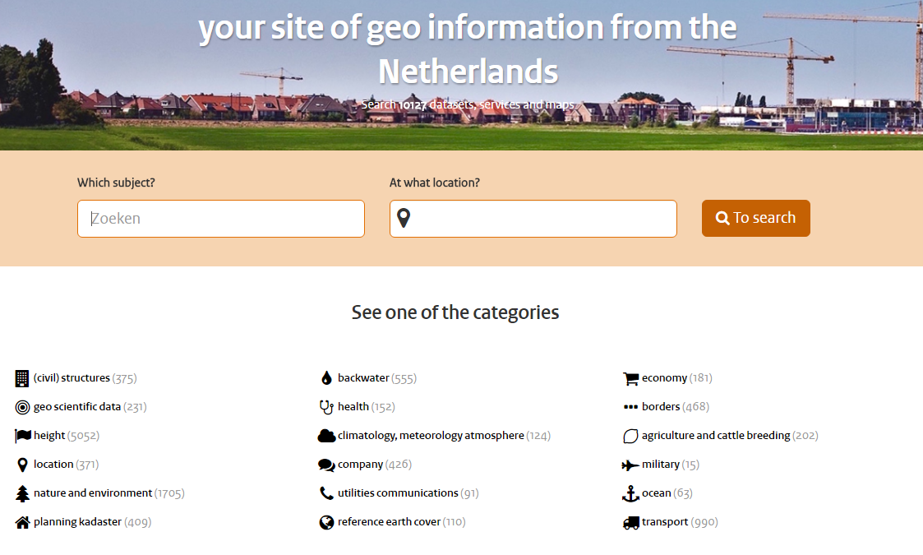
Cloud Application for
Public Administration
3. NGR national Geo Register
Higher School of Economics , Moscow, 2016

Slide 14
Cloud Strategy for
Public Administration
4. The Slovenian cloud strategy for Public Administration
  Strategy Drivers:
    • Cost saving
    • Economic impact for the private sector
  Main objective:
    • Increased innovation opportunities for service providers, including SMEs and public administrations, evidenced through implementations of advanced cloud infrastructures and services
    • Promotion of the reuse of open data and open service solutions in cloud environments, in particular published by public administrations
Higher School of Economics , Moscow, 2016

Slide 15
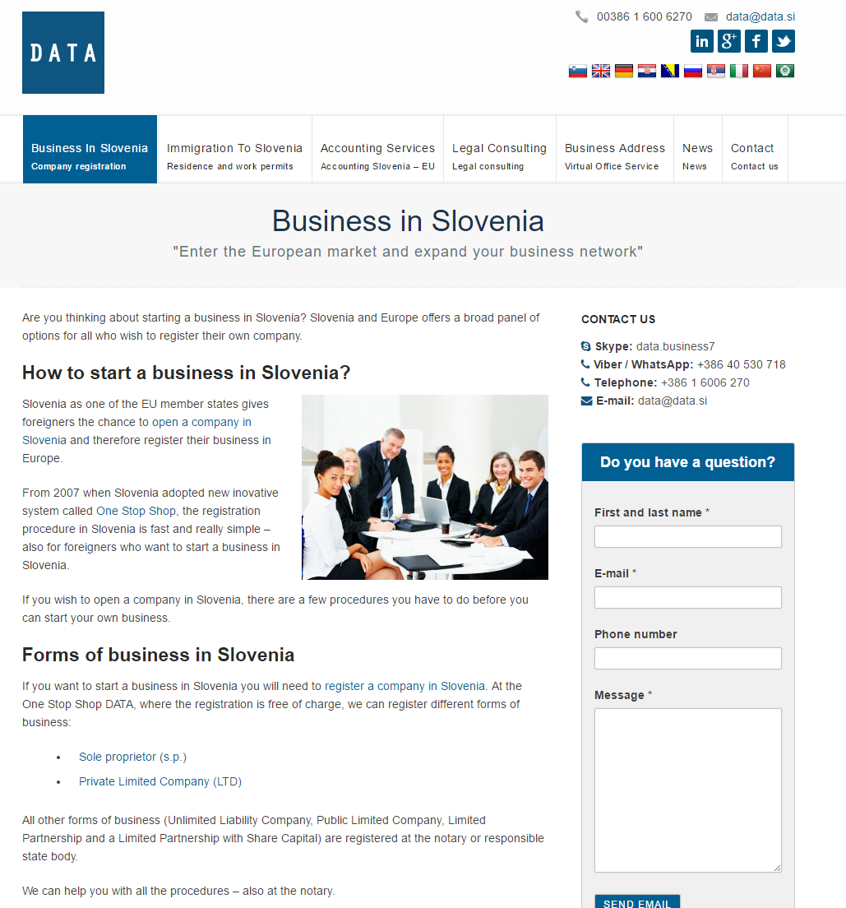
Cloud Application for
Public Administration
1. The one stop shop for entrepreneurs
Higher School of Economics , Moscow, 2016
Notes:
The portal e-VEM - one stop shop has been operating since 1 July 2005. The basic purpose of the e-VEM project is to provide a suitable information support for the future entrepreneur and enable him/her to start business operations in the shortest time possible.

Slide 16
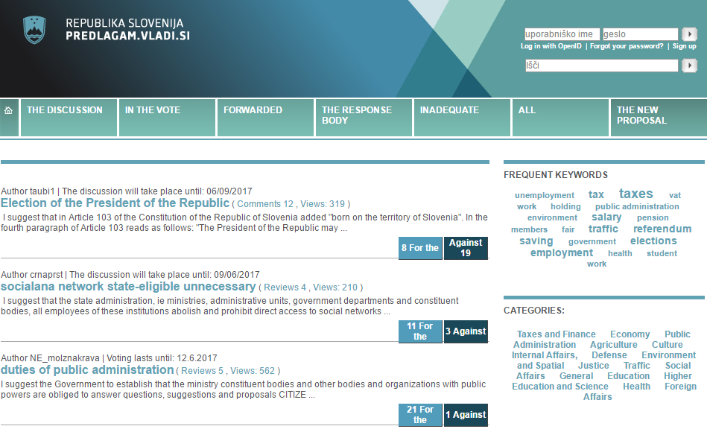
Cloud Application for
Public Administration
2. The e- Democracy portal
Higher School of Economics , Moscow, 2016
Notes:
The e- Democracy portal allows coverage of all essential steps in the process of adopting a legal act, operating uniformly in all spheres of competence, which are involved in the process of preparing and adopting legislation.

Slide 17
Cloud Strategy for
Public Administration
3. The Austrian cloud strategy for Public Administration
  Strategy Drivers:
    • Cost saving
    Improvement public services
  Main objective:
    • Providing E-Gov services to citizens at ease
Higher School of Economics , Moscow, 2016
Notes:
The e- Democracy portal allows coverage of all essential steps in the process of adopting a legal act, operating uniformly in all spheres of competence, which are involved in the process of preparing and adopting legislation.

Slide 18
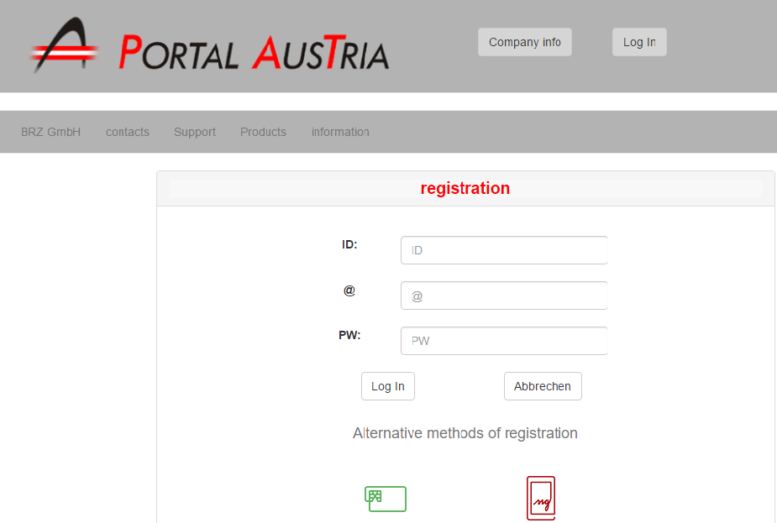
Cloud Application for
Public Administration
1. eGov Portal Services
Higher School of Economics , Moscow, 2016
Notes:
One of the best known cloud infrastructures developed Austrian government through the shared service portal “Portal Austria – portal.at”, based on the enterprise “eGov Portal Services” portal solution. This central governmental portal solution represents a shared-ICT-service portal. The examples of services, accessible through Portal Austria are the central federal personal management, the federal billing allocation, the system of resident registration or the central land registry.

Slide 19
Conclusion
Cloud computing is cost effective
It helps to provide more reliable and efficient public services
It has revolutionized the public administration industry because it filled the gap of IT infrastructure in public sector
Now public services can accessed 24 hours
It helps countries to increase their economic growth through
e-Business services
Higher School of Economics , Moscow, 2016
Notes:
In conclusion, the cloud computing technology has revolutionized the public administration through online services for public. It also helps countries to reduces cost of public services and provide public services to their citizens 24 hours.

Slide 20
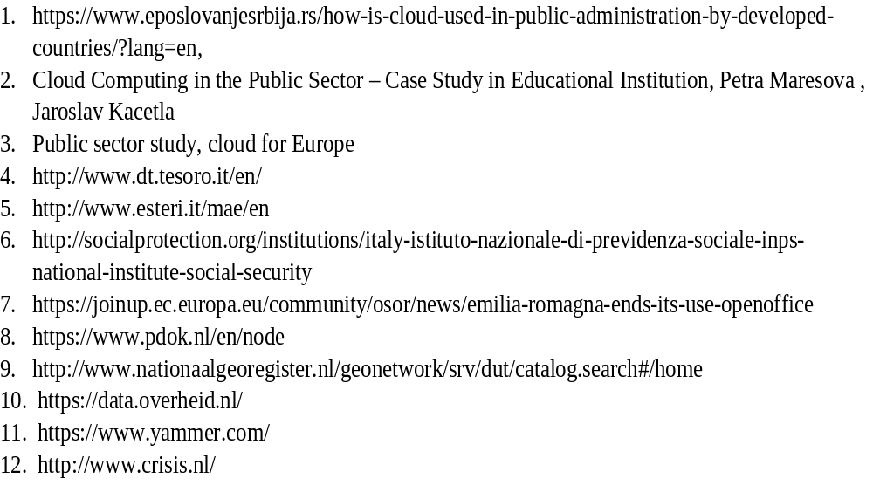
References
Higher School of Economics , Moscow, 2016

Slide 21

Questions please!

